Slide 1
Driver Drowsiness Detection

Slide 2
ABSTRACT
Drowsy driving is one of the major causes of road accidents and death.
The Main aim of this project is to develop a Drowsiness Detection System. The focus will be placed on designing a system that will monitor the open or closed state of the eyes in real-time.
In this Driver Drowsiness Monitoring system, a webcam records the video and driver’s face is detected in each frame.
Facial landmarks on the detected face are pointed out using Support Vector Machine (SVM).
Then SVM is used to check whether detected object is face or non-face. It further monitors the Eye Aspect Ratio (EAR) and Mouth Opening Ratio (MOR) of the driver up to a fixed number of frames to check the sleepiness and yawning.
If sleepiness is detected, a warning alert is given to the driver through an alarm.

Slide 3
INTRODUCTION
A low cost, real time driver drowsiness monitoring system has been proposed based on visual behaviour and machine learning.
This system works by monitoring the eyes of the driver and sounding an alarm when he/she is drowsy.
In this project the eye blink of the driver is detected. If the drivers eyes remain closed, then the driver is said to be drowsy and an alarm is sounded.
The purpose of this is to provide a real-time monitoring system using video processing, face/eye detection techniques.

Slide 4
PROBLEM STATEMENT
Designing a Drowsiness Detection System which will focus on continuously and accurately monitoring the state of the driver’s eyes in real time to check whether they are open or closed for more than a given period of time.The proposed work is to alert the driver when the person is drowsy or distracted.
To Design a System that will detect Drowsiness and take necessary steps to avoid accidents.

Slide 5
OBJECTIVE
The Project focuses on these objectives, which are:
The driver drowsiness detection is developed on eye closure of the driver can differentiate normal eye blink and drowsiness and detect drowsiness while driving.
To suggest ways to detect fatigue and drowsiness while driving.
To study on eyes and mouth from the video images of participants that can be used as an indicator of fatigue and drowsiness.
To develop a system that use eyes closure and yawning as a way to detect fatigue and drowsiness.

Slide 6
EXISTING SYSTEM
The Existing system of driver drowsiness detection system has following disadvantages. Mainly, using of two cameras in the system one for monitoring the head movement and the other one for facial expressions.
The other disadvantage is aging of sensors and all these sensors are attached to the driver’s body which may affect the driver. So to overcome all these disadvantages we designed a system in which a live camera is used for monitoring the driver drowsiness condition and alert the driver which reduces the road accidents.

Slide 7
PROPOSED SYSTEM
In Proposed System we develop a low-cost, real time driver’s drowsiness detection system with acceptable accuracy.
Hence, we have proposed a webcam-based system to detect driver’s fatigue from the face image only using image processing and machine learning techniques to make the system low-cost as well portable camera will be positioned in front of the driver to capture the front face image.
From the facial landmarks, eye aspect ratio, mouth opening ratio and position of the head are quantified and using these features and machine learning approach, a decision is obtained about the drowsiness of the driver.
If drowsiness is detected, an alarm will be sent to the driver to alert him/her.

Slide 8
LITERATURE SURVEY
Here are few titles of the papers which we referred:
1)Monitoring Driver Fatigue using Facial Analysis Techniques – Authors : S. Singh, N. P. papa Nikolopoulos [1]
2) Intelligent Video-Based Drowsy Driver Detection System under Various Illuminations and Embedded Software Implementation- Authors: Wei-LiangOu, Ming-Ho Shih [2]
3) Driver drowsiness detection system - Authors::Belal Alshaqaqi , Abdullah Salem [3]
4) Driver Fatigue Detection based on Eye Tracking and Dynamic Template Matching – Authors : W. B. Horng, C. Y. Chen, Y. Chang, C. H. Fan [4]
5) Driver Drowsiness Detection System and Techniques-Authors:Vandna Saini, Rekha Saini [5]
6) Driver drowsiness detection system under infrared illumination for an intelligent vehicle- Authors: M.J. Flores J. Ma Armingol A. de la Escalera [6]
7) Driver drowsiness detection using face expression recognition, in: Signal and Image Processing Applications-Authors: M. A. Assari, M. Rahmati [7]

Slide 9
SYSTEM METHODLOGY
ARCHITECTURE OF PROPOSED SYSTEM:
At first, the video is recorded using a webcam. The camera will be positioned in front of the driver to capture the front face image. From the video, the frames are extracted to obtain 2-D images.
Face is detected in the frames using histogram of oriented gradients (HOG) and linear support vector machine (SVM) for object detection. After detecting the face, facial landmarks like positions of eye, nose, and mouth are marked on the images.
From the facial landmarks, eye aspect ratio, mouth opening ratio and position of the head are quantified and using these features and machine learning approach, a decision is obtained about the drowsiness of the driver. If drowsiness is detected, an alarm will be sent to the driver to alert him/her.

Slide 10
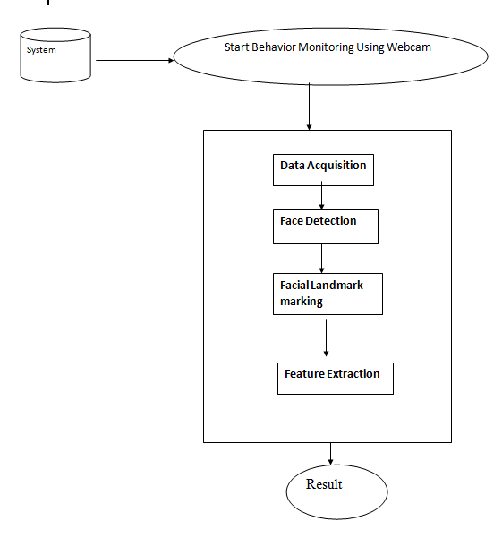
OVERVIEW OF PROPOSED SYSTEM

Slide 11
a) Data Acquisition
The video is recorded using webcam and the frames are extracted and processed in a laptop. After extracting the frames, image processing techniques are applied on these 2D images. Presently, synthetic driver data has been generated. The volunteers are asked to look at the webcam with intermittent eye blinking, eye closing, yawning and head bending.
Face Detection
After extracting the frames, first the human faces are detected. Numerous online face detection algorithms are there. In this study, histogram of oriented gradients (HOG) and linear SVM method is used. In this method, positive samples of descriptors are computed on them. Subsequently, negative samples (samples that do not contain the required object to be detected i.e., human face here) of same size are taken and HOG descriptors are calculated. Usually the number of negative samples is very greater than number of positive samples. After obtaining the features for both the classes, a linear SVM is trained for the classification task. To improve the accuracy of SVM, hard negative mining is used. In this method, after training, the classifier is tested on the labeled data and the false positive sample feature values are used again for traning purpose.

Slide 12
Facial Landmark Marking & Feature Extraction
After detecting the face, the next task is to find the locations of different facial features like the corners of the eyes and mouth, the tip of the nose and so on. Prior to that, the face images should be normalized in order to reduce the effect of distance from the camera, non-uniform illumination and varying image resolution. Therefore, the face image is resized to a width of 500 pixels and converted to grayscale image. After image normalization, ensemble of regression trees is used to estimate the landmark positions on face from a sparse subset of pixel intensities.

Slide 13
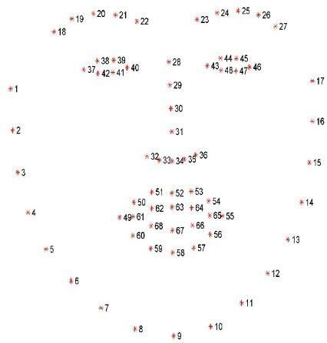
Fig: Facial Landmark predictor

Slide 14
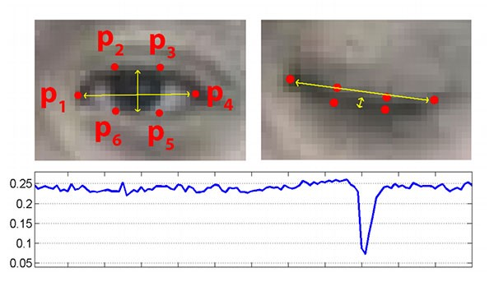
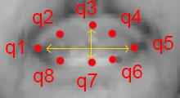
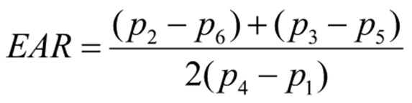
Fig : Mouth Opening Ratio
Fig: Eye Aspect Ratio

Slide 15
EXPERIMENTAL ANALYSIS
In this project by monitoring Visual Behaviour of a driver with webcam and machine learning SVM (Support Vector Machine) algorithm we are detecting Drowsiness in a driver. This application will use inbuilt webcam to read pictures of a driver and then using OPENCV SVM algorithm extract facial features from the picture and then check whether driver in picture is blinking his eyes for consecutive 20 frames or yawning mouth then application will alert driver with Drowsiness messages. We are using SVM pre-trained drowsiness model and then using Euclidean distance function we are continuously checking or predicting EYES and MOUTH distance closer to drowsiness, if distance is closer to drowsiness then application will alert driver.
.
State | EAR | MOR
Normal | 0.26 | 0.47
Yawning | 0.16 | 0.45
Eye Closed | 0.27 | 0.98

Slide 16
CONCLUSION
A low cost, real time driver drowsiness monitoring system has been proposed based on visual behaviour and machine learning.
Here, visual behaviour features like eye aspect ratio and mouth opening ratio are computed from the streaming video, captured by a webcam.
The driver drowsiness is analysed and driver’s drowsiness is detected and alert system is also designed.

Slide 17
FUTURE SCOPE
We intend to extend the work by considering following aspects of driving and driver of the vehicle which
will further improve the system making it more robust.
Using ‘k previous frames’ to stabilize the landmark points
To use the head orientation of the driver as a fatigue monitoring approach
To observe the stress factor of the person based on the behavioral traits as captured by camera and sensors in the vehicle
To detect the yawning frequency of the driver for making decision

Slide 18
REFERENCES
[1] W. L.Ou, M. H. Shih, C. W. Chang, X. H. Yu, C. P. Fan, "Intelligent Video-Based Drowsy Driver Detection System under Various Illuminations and Embedded Software Implementation", 2015 international Conf. on Consumer Electronics - Taiwan, 2015.
[2] W. B. Horng, C. Y. Chen, Y. Chang, C. H. Fan, “Driver Fatigue Detection based on Eye Tracking and Dynamic Template Matching”, IEEE International Conference on Networking,, Sensing and Control, Taipei, Taiwan, March 21-23, 2004.
[3] S. Singh, N. P. papanikolopoulos, “Monitoring Driver Fatigue using Facial Analysis Techniques”, IEEE Conference on Intelligent Transportation System, pp 314-318.
[4] B. Alshaqaqi, A. S. Baquhaizel, M. E. A. Ouis, M. Bouumehed, A. Ouamri, M. Keche, “Driver Drowsiness Detection System”, IEEE International Workshop on Systems, Signal Processing and their Applications, 2013.
[5] Vandna Saini, Rekha Saini “Driver Drowsiness Detection System and Techniques”, IJCSIT, Vol. 5 (3).
[6] M.J. Flores J. Ma Armingol A. de la Escalera, “Driver drowsiness detection system under infrared illumination for an intelligent vehicle” Published in IET Intelligent Transport Systems Received on 13th October 2009 Revised on 1st April 2011.
[7] M. A. Assari, M. Rahmati, Driver drowsiness detection using face expression recognition, in: Signal and Image Processing Applications (ICSIPA), 2011 IEEE International Conference on, IEEE, 2011, pp. 337– 341

Slide 19
THANK YOU

